Slide 1
OLTP
On-Line Transaction Processing

Slide 2
What is OLTP? (aka Operational Data Store)
The OLTP database records transactions in real time and aims to automate clerical data entry processes of a business entity.
Addition, modification and deletion of data in the OLTP database is essential and the semantics of the application used in the front end impact on the organization of the data in the database.

Slide 3
Application of OLTP
OLTP has also been used to refer to processing in which the system responds immediately to user requests. An automatic teller machine (ATM) for a bank is an example of a commercial transaction processing application.

Slide 4
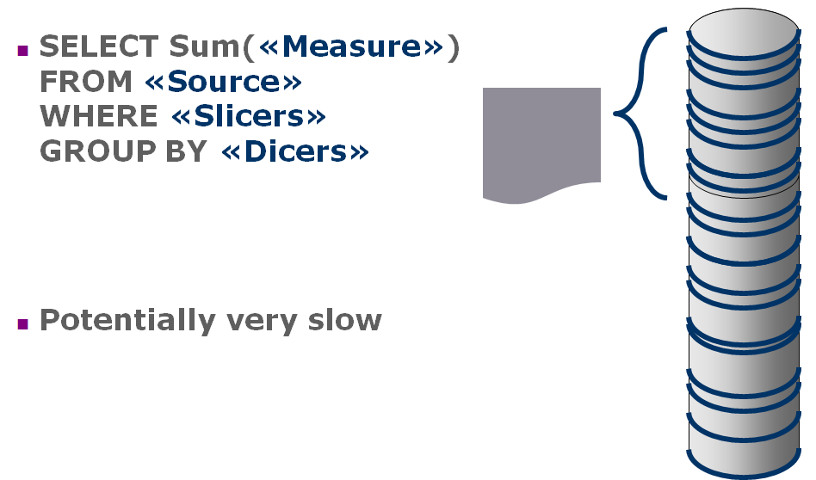
Relational Data Retrieval

